Slide 2
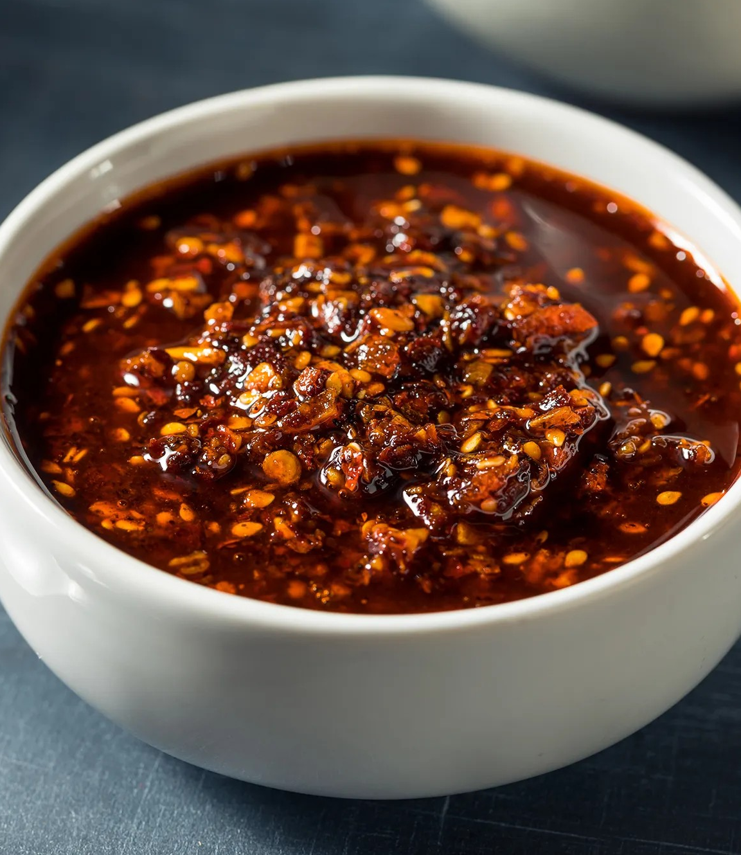
ALL ABOUT CHILI CRISP
Chili crisp, also known as chili crunch, is a spicy, crunchy, umami-packed condiment that has won over chefs and food lovers worldwide. It originated in Chinese cuisine, where chili-infused oils have been used for centuries. In southern China, ingredients are simmered in oil, while in the north, hot oil is poured over spices to create a fragrant, textured topping. Each region, and often each household, has its own version, making it a personal and culturally rich tradition.
Globally, variations of chili crisp exist under different names and formats. In Mexico, salsa macha shares a similar composition, using local chiles and nuts. In Cambodia, Mama Teav’s offers a garlic-forward version based on a family recipe.
The condiment gained international prominence in 1997 when Tao Huabi, a Chinese restaurateur, began commercial production under the Lao Gan Ma brand in Guizhou province. Her chili crisp quickly became a pantry staple in China and found a cult following abroad. Lao Gan Ma is credited with popularizing Chinese chili oil and chili crisp toppings in the Western world.
The condiment saw a new wave of popularity in the U.S. in the late 2010s, with a surge in interest during the COVID-19 pandemic, as home cooks explored bold new flavors. Despite its humble roots, chili crisp has become a gourmet item, appearing in fine-dining dishes, fusion cuisine, and even desserts like vanilla ice cream, where its savory heat contrasts beautifully with sweet flavors.
In 2023, a trademark was secured for "chile crunch" and "chili crunch," sending cease-and-desist letters to small producers using similar terms. This triggered backlash over the trademarking of a traditional condiment’s name, with critics arguing it commodifies cultural heritage.
ACF IOTM
JULY 2025
CHILI CRISP

Slide 3
HEALTHY INGREDIENT CONTRIBUTION
Chili crisp, while best known for its bold flavor and texture, also contains several ingredients with potential health benefits though it's important to note that it’s typically used in moderation due to its high oil content. Listed below you will find ingredients commonly found in chili crisp and what potential health benefits they contribute.
Chilies: Chilies are rich in capsaicin, the compound responsible for their heat. Capsaicin has been studied for its anti-inflammatory, metabolism-boosting, and pain-relief properties. It may also help reduce appetite and support cardiovascular health.
Garlic: Garlic is a well-known antimicrobial and immune-supporting ingredient. It contains compounds like allicin, which may help reduce blood pressure, lower cholesterol, and support heart health.
Shallot/Onion: These add depth of flavor and are sources of antioxidants, such as quercetin, which has anti-inflammatory and antihistamine effects.
Sichuan Peppercorns: These unique peppercorns contain hydroxy-alpha-sanshool, which has been linked to mild pain-relieving effects. They may also stimulate digestion and circulation.
Fermented Ingredients: Ingredients such as fermented soybeans or black beans offer gut-friendly probiotics and enzymes that aid digestion and nutrient absorption.
Neutral Oils: While oils like soybean or canola are typically used and are calorie-dense, some artisanal versions use healthier oils such as olive oil, which is high in monounsaturated fats and may support heart health.
Nutritional Information/Values from USDA FoodData Central
ACF IOTM
JULY 2025
CHILI CRISP

Slide 4
TYPES AND VARIETIES
Chili crisp comes in a wide range of styles, reflecting regional traditions, ingredient variations, and modern culinary twists. While the core idea remains the same, crispy bits suspended in flavorful chili oil, there are many distinct types and varieties of chili crisp found around the world and on store shelves today.
Global Variations
Lao Gan Ma (China)
Original chili crisp from Guizhou province
Dried chili, fermented soybeans, garlic, peanuts
Mild to medium heat, strong umami
Sichuan-Style (China)
Includes Sichuan peppercorns for numbing sensation
Garlic, ginger, star anise, sesame seeds
Popular in Chengdu and Chongqing cuisine
Salsa Macha (Mexico)
Often uses olive oil or avocado oil as base
Dried chiles, nuts, seeds, garlic
Smokier and nuttier than Chinese varieties
Nam Prik Pao (Thailand)
Chili jam with sweet, savory, and smoky notes
Palm sugar, tamarind, dried shrimp, fish sauce
Artisanal & Modern Brands
Fly By Jing
Sichuan-inspired, small batch
Features all natural ingredients
Known for a balance of heat, numbing, and umami
Momofuku Chili Crunch
Created by Chef David Chang
Uses chili flakes, garlic, shallots, sesame, and seaweed
Several variations including black truffle and hot honey
Boon Sauce
LA-based chili crisp with Southeast Asian influence
Garlic-heavy, slightly sweet, and a rich, smoky flavor
Zhong Sauce
Sweet, savory, and slightly spicy dipping sauce
Chili oil-based but thicker and richer
ACF IOTM
JULY 2025
CHILI CRISP

Slide 5
SELECTING AND STORING
Selecting Chili Crisp:
Flavor Profile
Spicy vs. Mild: Some varieties bring intense heat while others are milder and more aromatic
Umami Depth: Look for versions with fermented soybeans, mushrooms, or seaweed for savory complexity
Sweet or Smoky: Mexican-style salsa macha or versions with added sugar or smoked chilies may have a sweeter or smokier character
Texture
Chunky variations contain generous pieces of garlic, shallots, or peanuts
Finer blends may be more oil-based with fewer crunchy bits
Dietary Considerations
Vegan or Vegetarian: Some chili crisps include dried shrimp or fish sauce but others are entirely plant-based
Low Sodium/Oil: Options may be available for those watching their intake
Usage Intent:
For versatile, everyday use, go with a classic and select variations with unusual ingredients like black truffle for special pairings
Packaging & Quality:
Opt for jars with clear expiration dates and ingredient lists
Small-batch or artisanal products often use better quality oils and spices but may be pricier
Storing Chili Crisp:
Unopened Jar: Store in a cool, dark pantry away from direct sunlight and monitor best-by date
After Opening: Shelf stable after opening but refrigeration is recommended
Shelf Life: In refrigeration it can keep for 6 months to a year but may go rancid or spoil quicker when in warmer climates left at room temperature
ACF IOTM
JULY 2025
CHILI CRISP

Slide 6
CULINARY USES
Breakfast & Morning
Drizzled over eggs or mixed into egg salad
Spicy compound butter for toast
Breakfast grain bowls with soft-boiled egg
Snacks & Appetizers
Pair with grilled bread and cheese
Whipped into feta or labneh for mezze
Fold into biscuit or muffin batters
Salads & Vegetables
Whisked into vinaigrettes and dressings
Drizzled over charred vegetables
Mixed into pickle brines
Noodles & Rice
Use as base for Sichuan-style cold noodle salads
Add crunch and spice to poke bowls
Finish stir-fried greens and proteins
Proteins & Mains
Marinade base or finishing oil for beef and chicken
Blend into mayo, aioli, and finishing sauces
Marinate tofu for bowls and skewers
Baked Goods & Carbs
Incorporate into focaccia, cornbread, or bagels
Pair with chocolate and peanut butter
Flavor ice cream and gelato bases
Cross-Cultural Pairings
Falafel & Tahini
Tacos & Crema
Grilled Cheese & Tomato
Drinks & Other
Rimming glasses with salt and sesame
Blend into mezcal-based cocktails
Combine with caramel for a spicy dessert sauce
ACF IOTM
JULY 2025
CHILI CRISP

Slide 7
INTERESTING FACTS
Between 2020 and 2023, U.S. sales of chili crisp and chili oils grew over 300%
Often dubbed the "OG" of chili crisp, Lao Gan Ma sells over a million jars daily worldwide while the “Fly by Jing” brand hit $10 million in revenue in 2022
In China, over 40 counterfeit versions of Lao Gan Ma appeared in the early 2000s prompting lawsuits and government crackdowns
While exact figures vary by region, the chili crisp and chili oil condiment category is estimated to be worth over $100 million globally
Searches for #chilicrisp have topped 100+ million views across social platforms
Small-batch brands like "Freaky Ferments" have created extreme heat versions of chili crisp using the Carolina Reaper chili pepper
At events like the Specialty Food Association’s SOFI Awards, chili crisps are now an entire subcategory, with artisan entries competing on flavor complexity, innovation, and sustainability
Services like The Spicy Box and Chili Crisp Club offer monthly deliveries of curated hot oils and chili crisps from around the world
In 2024, Panda Express, Shake Shack, and Sweetgreen all tested or released limited-run chili crisp–inspired menu items
ACF IOTM
JULY 2025
CHILI CRISP

Slide 8
RECIPE
Chili Crisp Pickled Melon Salad Yield: 4 Servings
Ingredients:
¼ Cup Rice Wine Vinegar
2 Tsp Sugar
½ Tsp Kosher Salt
½ Lime, Zested
1 Cup Cantaloupe, ¾-inch Cubed
1 Cup Watermelon, ¾-inch Cubed
1 Cup Cucumber, Small Dice
2 Tbsp Chili Crisp
¼ Cup Feta Cheese, Crumbled
2 Tbsp Peanuts, Toasted & Chopped
1 Tbsp Lime Juice
1 Tbsp Mint, Chiffonade
1 Tsp Sesame Oil
Flaky Salt, To Finish
Directions:
In a medium bowl, whisk together the rice vinegar, sugar, salt, and lime zest until dissolved. Add melon cubes and gently toss to coat.
Let sit in the fridge for at least 30 minutes (or up to 2 hours) to chill and lightly pickle.
After pickling, drain off the liquid, don’t rinse. In a large serving bowl, combine the melon, cucumber, and lime juice. Toss gently.
Drizzle with chili crisp, letting both oil and crispy bits coat the salad. Top with feta, peanuts, herbs, and a small drizzle of sesame oil if using.
Finish with a pinch of flaky salt and more chili crisp to taste.
ACF IOTM
JULY 2025
CHILI CRISP

Slide 9
QUIZ
After you read through this month’s Ingredient of the Month, take this quiz to test your knowledge. In order to earn continuing education hours (CEHs) from the American Culinary Federation (ACF), the test must be completed through the ACF’s Online Learning Center. Seventy-five percent accuracy is required to earn one hour of continuing education credits toward professional certification.
ACF IOTM
JULY 2025
CHILI CRISP

Slide 10
QUIZ
Question #1
Who helped bring chili crisp to international prominence with commercial production?
David Chang
Tao Huabi
Roy Choi
Andrea Nguyen
ACF IOTM
JULY 2025
CHILI CRISP

Slide 11
QUIZ
Question #2
The trademarking of the terms “chili crunch” and “chile crunch” in 2023 caused controversy because:
It banned imports of Lao Gan Ma
It was enforced by the Chinese government
It was seen as commodifying a cultural tradition
It raised food safety concerns
ACF IOTM
JULY 2025
CHILI CRISP

Slide 12
QUIZ
Question #3
Which compound in chilies is responsible for their heat and associated health benefits?
Allicin
Quercetin
Sanshool
Capsaicin
ACF IOTM
JULY 2025
CHILI CRISP

Slide 13
QUIZ
Question #4
Which ingredient in chili crisp contains hydroxy-alpha-sanshool, which may have pain-relieving effects?
Fermented Black Beans
Garlic
Sichuan Peppercorns
Shallots
ACF IOTM
JULY 2025
CHILI CRISP

Slide 14
QUIZ
Question #5
Which chili crisp brand is known for incorporating seaweed, garlic, and has flavor variations like black truffle and hot honey?
Boon Sauce
Fly By Jing
Momofuku Chili Crunch
Zhong Sauce
ACF IOTM
JULY 2025
CHILI CRISP

Slide 15
QUIZ
Question #6
Zhong Sauce is oil-based but thicker and used more like a dipping sauce than a topping.
True
False
ACF IOTM
JULY 2025
CHILI CRISP

Slide 16
QUIZ
Question #7
Why might someone choose a small-batch or artisanal chili crisp?
It is cheaper
It uses better quality ingredients
It uses more ingredients
It is usually less spicy
ACF IOTM
JULY 2025
CHILI CRISP

Slide 17
QUIZ
Question #8
Refrigerating chili crisp, often very perishable, after opening can help it last up to 3 months.
True
False
ACF IOTM
JULY 2025
CHILI CRISP

Slide 18
QUIZ
Question #9
It’s not safe or recommended to use chili crisp in baked goods like cornbread or focaccia.
True
False
ACF IOTM
JULY 2025
CHILI CRISP

Slide 19
QUIZ
Question #10
The global market value of the chili crisp and chili oil condiment category is estimated at over:
$10 Million
$50 Million
$100 Million
$500 Million
ACF IOTM
JULY 2025
CHILI CRISP

Slide 20
JOIN US NEXT MONTH!
Stay tuned for the next ACF Ingredient of the Month! Be sure to visit the Online Learning Center (OLC) to download a copy of each month’s ingredient presentation. Don’t forget to take the official IOTM quiz through the OLC to earn one hour of continuing education credits toward professional certification.
For more information:
www.acfchefs.org
www.acfchefs.org/olc
www.acfchefs.org/iotm
ACF IOTM
JULY 2025
CHILI CRISP

